Slide 1
Public Key Cryptography
RSA
Adopted from “Cryptography and Network Security” by W. Stallings
Notes:
Lecture slides by Lawrie Brown for “Cryptography and Network Security”, 4/e, by William Stallings, Chapter 9 – “Public Key Cryptography and RSA”.

Slide 2
Private-Key Cryptography
Traditional private/secret/single key cryptography uses one key.
Key disclosed
Confidentiality of communications compromised
Repudiation of sender compromised ➔The receiver may forge a message & claims that it is sent by sender
Notes:
So far all the cryptosystems discussed, from earliest history to modern times, have been private/secret/single key (symmetric) systems.
All classical, and modern block and stream ciphers are of this form, and still rely on the fundamental building blocks of substitution and permutation (transposition).

Slide 3
Public-Key Cryptography
Uses two keys – a public & a private key
Asymmetric – Both parties are not using the same key
Complements private key cryptography
Uses number theoretic concepts
Notes:
Will now discuss the radically different public key systems, in which two keys are used. The development of public-key cryptography is the greatest and perhaps the only true revolution in the entire history of cryptography. It is asymmetric, involving the use of two separate keys, in contrast to symmetric encryption,which uses only one key. Anyone knowing the public key can encrypt messages or verify signatures, but cannot decrypt messages or create signatures, counter-intuitive though this may seem. It works by the clever use of number theory problems that are easy one way but hard the other. Note that public key schemes are neither more nor less secure than private key (security depends on the key size for both), nor do they replace private key schemes (they are too slow to do so), rather they complement them. Both also have issues with key distribution, requiring the use of some suitable protocol.

Slide 4
Why Public-Key Cryptography?
Solve 2 key issues:
key distribution – enable secure communications (in general) without having to trust a KDC with your key
digital signatures – enable verification of a message from the claimed sender
Invented (publicly) by Whitfield Diffie & Martin Hellman at Stanford Uni in 1976
known earlier in classified community
Notes:
The concept of public-key cryptography evolved from an attempt to attack two of the most difficult problems associated with symmetric encryption: key distribution and digital signatures. The idea of public key schemes, and the first practical scheme, which was for key distribution only, was published in 1977 by Diffie & Hellman. The concept had been previously described in a classified report in 1970 by James Ellis (UK CESG) - and subsequently declassified [ELLI99]. Its interesting to note that they discovered RSA first, then Diffie-Hellman, opposite to the order of public discovery! There is also a claim that the NSA knew of the concept in the mid-60’s [SIMM93].

Slide 5
Public-Key Cryptography
Public-key/two-key/asymmetric cryptography uses two keys:
a public-key, which may be known by anybody, and can be used to encrypt messages, and verify signatures
a private-key, known only to the recipient, used to decrypt messages, and sign (create) signatures
Asymmetric because
those who encrypt messages or verify signatures cannot decrypt messages or create signatures
Notes:
Emphasize here the radical difference with Public-Key Cryptography is the use of two related keys but with very different roles and abilities. Anyone knowing the public key can encrypt messages or verify signatures, but cannot decrypt messages or create signatures, all thanks to some clever use of number theory.

Slide 6
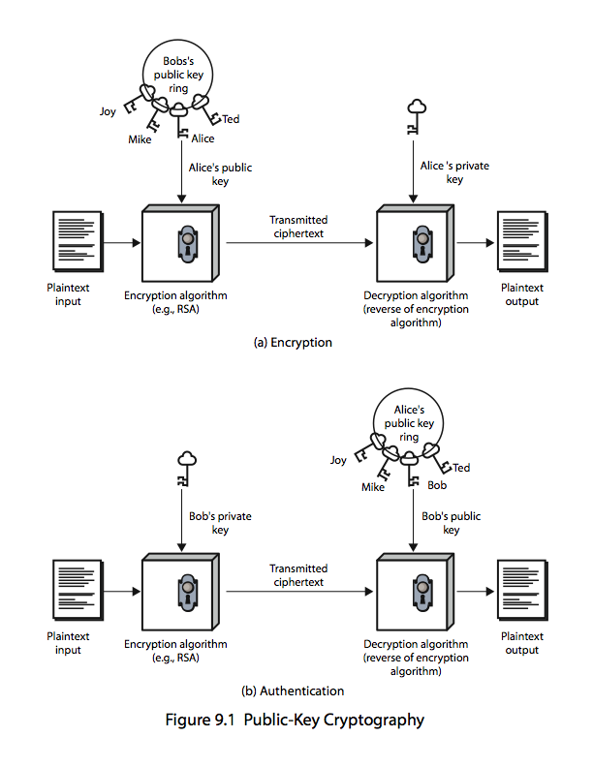
Public-Key Cryptography
Notes:
Stallings Figure 9.1a “Public-Key Cryptography”, shows that a public-key encryption scheme has six ingredients: plaintext, encryption algorithm, public & private keys, ciphertext & decryption algorithm.
Consider the following analogy using padlocked boxes: traditional schemes involve the sender putting a message in a box and locking it, sending that to the receiver, and somehow securely also sending them the key to unlock the box. The radical advance in public key schemes was to turn this around, the receiver sends an unlocked box (their public key) to the sender, who puts the message in the box and locks it (easy - and having locked it cannot get at the message), and sends the locked box to the receiver who can unlock it (also easy), having the (private) key. An attacker would have to pick the lock on the box (hard).

Slide 7
Public-Key Characteristics
Public-Key algorithms require:
Easy to en/decrypt messages when the relevant (en/decrypt) key is known.
(using exponentiation, multiplication)
Hard to find the decryption key when only (1) algorithm, (2) encryption key are known
(using logs, factoring)
The two related keys can be switched for encryption, (while the other must be used for) decryption
(for some algorithms)
Notes:
Asymmetric algorithms rely on one key for encryption and a different but related key for decryption. These algorithms have the following important characteristic: that it is computationally infeasible to determine the decryption key given only knowledge of the cryptographic algorithm and the encryption key. That is public key schemes utilise problems that are easy (P type) one way but hard (NP type) the other way, eg exponentiation vs logs, multiplication vs factoring. In addition, some algorithms, such as RSA, are also able to use either key as public & other private.

Slide 8
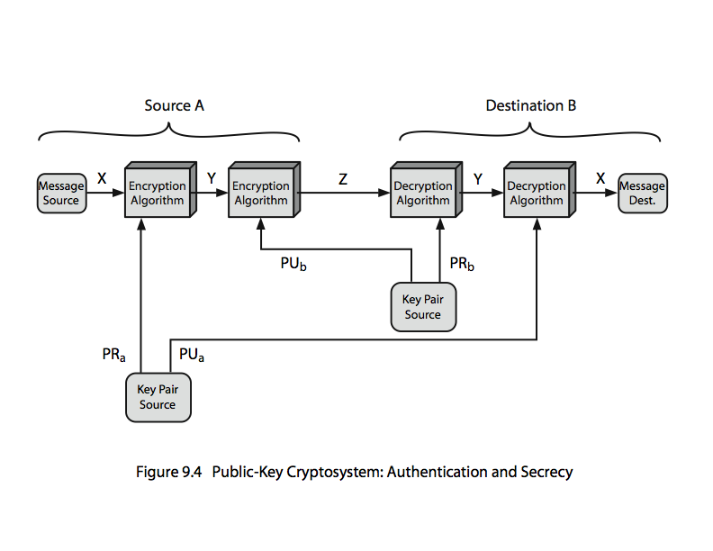
Public-Key Cryptosystems
Encryption twice for secrecy and authentication, Not done due to CPU cost
Notes:
In this case, separate key pairs are used for each of these purposes. The receiver owns and creates secrecy keys, sender owns and creates authentication keys.
In practice typically DO NOT do this, because of the computational cost of public-key schemes. Rather encrypt a session key which is then used with a block cipher to encrypt the actual message, and separately sign a hash of the message as a digital signature - this will be discussed more later.
Note that public-key schemes can be used for either secrecy or authentication, or both (as shown here).
Stallings Figure 9.4 “Public-Key Cryptosystems: Secrecy and Authentication” illustrates the essential elements of a public-key encryption scheme.

Slide 9
Public-Key Cryptography Applications
Public Key cryptography could be use for:
encryption/decryption (provide secrecy)
digital signatures (provide authentication)
key exchange (of session keys)
Not all algorithms are suitable for the 3 applications listed above (e.g Diffie–Hellman is used for key exchange, RSA for encryption / decryption, DSA for digital Signature)
Notes:
Recap : DH aims to create a shared secret (key exchange) . DH uses discrete logarithm
RSA aims to encrypt / decrypt , uses discrete root , factorization
Both have “public” and “private” components

Slide 10
Security of Public Key Schemes
Brute force (exhaustive search) attack is always theoretically possible.
Made hard enough to be impractical to break by using large keys
RSA claims
1024-bit RSA keys = 80-bit symmetric keys (before 2006)
2048-bit RSA keys = 112-bit symmetric keys (before 2030)
3072-bit RSA keys = 128-bit symmetric keys (requried after 2030)
Public Key cryptography is slow compared to private key cryptography
Notes:
Public key schemes are no more or less secure than private key schemes - in both cases the size of the key determines the security. Note also that you can't compare key sizes - a 64-bit private key scheme has very roughly similar security to a 512-bit RSA - both could be broken given sufficient resources. But with public key schemes at least there is usually a firmer theoretical basis for determining the security since its based on well-known and well studied number theory problems.

Slide 11
RSA
Invented by Rivest, Shamir & Adleman in 1977
Best known & most widely used public-key scheme
Encryption / Decryption based on exponentiation (easy)
Security of RSA is due to cost of factoring large numbers (hard)
Notes:
RSA is the best known, and by far the most widely used general public key encryption algorithm, and was first published by Rivest, Shamir & Adleman of MIT in 1978 [RIVE78]. Since that time RSA has reigned supreme as the most widely accepted and implemented general-purpose approach to public-key encryption. It is based on exponentiation in a finite (Galois) field over integers modulo a prime, using large integers (eg. 1024 bits). Its security is due to the cost of factoring large numbers.

Slide 12
RSA Key Setup
Each user generates a public/private key pair by:
Select two large primes at random - p, q
Compute their system modulus n=p.q
Compute φ(n)=(p-1)(q-1)
Select the encryption key e
where 1<e< φ(n),gcd(e,φ(n))=1
Find decryption key d by
e.d ≡ 1 (mod φ(n)) and 0≤d≤n
publish their public encryption key: PU={e,n}
Keep private decryption key: PR={d,n}
where [gcd ] = Greatest Common Divider
[φ(n)] = Euler's totient function of n. Phi of n
Notes:
Pay Special Attention
Best explained by watching this video https://www.youtube.com/watch?v=kYasb426Yjk
RSA key setup is done once (rarely) when a user establishes (or replaces) their public key, using the steps as shown. The exponent e is usually fairly small, just must be relatively prime to ø(n). Need to compute its inverse mod ø(n) to find d. It is critically important that the factors p & q of the modulus n are kept secret, since if they become known, the system can be broken. Note that different users will have different moduli n.
ø(n) is the number of positive integers coprime to and smaller than n.
Two popular values for e are: 3 and 65537 (2¹⁶ + 1).
Extended Euclidean Algorithm and Inverse Modulo calculation https://www.youtube.com/watch?v=fz1vxq5ts5I

Slide 13
RSA Key Setup example
Select primes: p=17 & q=11
Compute n = pq =17 x 11=187
Compute φ(n)=(p–1)(q-1)=16 x 10=160
Select e: gcd(e,160)=1; choose e=7 (relative prime)
Determine d: de≡1 (mod 160) and d < n
The first possible d value is 23 since 23x7=161≡ 1 (mod 160)
The next possible d is 183 as 183 x 7 ≡ 1 (mod 160) and it is smaller than 187 thus is acceptable.
Publish public key PU={7,187}
Keep secret private key PR={23,187} or PR={183,187}
Recommended videos : https://www.youtube.com/watch?v=kYasb426Yjk
https://www.youtube.com/watch?v=6TZD2E2ZW6o
Notes:
Pay Special Attention
Here walk through example RSA key generation using “trivial” sized numbers.
Selecting primes requires the use of a primality test.
Finding d as inverse of e mod ø(n) requires use of Euclid’s Inverse algorithm (see Ch4)

Slide 14
RSA Encryption / Decryption
To encrypt the message M :
Use public key of recipient PU={e,n}
Computes: C = Me mod n, where 0≤M<n
To decrypt the ciphertext C:
Use private key of owner PR={d,n}
Computes: M = C^{d} mod n
Note: The message M must be smaller than the modulus n (break M into blocks if needed)
Notes:
Pay Special Attention
The actual RSA encryption and decryption computations are each simply a single exponentiation mod (n). Note that the message must be smaller than the modulus. The “magic” is in the choice of the exponents which makes the system work.

Slide 15
RSA En/Decryption example
Given message (M) = "A" = 65, n = 187, e= 7, d=23 (note: 65<187)
Encryption:
C = 65⁷ mod 187 = 142
Decryption:
M = 142²³ mod 187 = 65 (Really ? Can you verify ?)
How about
M = 142¹⁸³ mod 187 = ???
Notes:
Pay Special Attention
Then show that the encryption and decryption operations are simple exponentiations mod 187.
Rather than having to laborious repeatedly multiply, can use the "square and multiply" algorithm with modulo reductions to implement all exponentiations quickly and efficiently (see next).

Slide 16
RSA attacks – Factoring
Brute force attack :
Given n,factor p.q -> compute ø(n) -> compute d
Determine ø(n) directly and compute d
Find d directly
Mathematical attack (on factoring)
Slow improvements over the years
as of Dec-09 best is 232 decimal digits (768 bits)
Improvement in algorithms and Quantum Computers could potentially break RSA
Currently recommend n ≥ 2048 bits long
Notes:
Next cycle AY1718 Merge Brute Force with next slide
We can identify three approaches to attacking RSA mathematically, as shown. Mathematicians currently believe all equivalent to factoring.
See Stallings Table 9.4 for progress in factoring, where see slow improvements over the years, with the biggest improvements coming from improved algorithms.
The best current algorithm is the “Lattice Sieve” (LS), which replaced the “Generalized Number Field Sieve” (GNFS), which replaced the “Quadratic Sieve”(QS).
Have to assume computers will continue to get faster, and that better factoring algorithms may yet be found.
Numbers of size 1024-2048 bits look reasonable at present, provided the factors meet other constraints.

Slide 17
RSA attacks - Misuse
Using common Modulus (N)
Reusing the same N with different d & e is not a safe way to generate public / private keys.
Using small public / private exponent
The d & e are modular multiplicative inverse (select 1, compute the other)
Short public exponent → Faster to encrypt / (for low powered device like smartcards)
Extreme tiny public exponent (i.e. e=3) is unsafe. Typically 65535 is commonly used & is good enough)
Long private exponent → Protect data, much harder to brute force.
Notes:
For small exponent (aka with value 3) the Chinese Remainder Theorem could be used

Slide 18
RSA attacks - Chosen Ciphertext Attacks
RSA is a deterministic encryption algorithm (aka cipher text is the same if message is unchanged)
Chosen ciphertext attack – Attacker send cipher text & gets plaintext back
Victim might not see the original cipher text
C’ = Cr^{e} (mod n) where r is chosen by attacker
M’= Mr (mod n) message (M) can be computed
Solution : Use random pad (padding) on plaintext
PKCS#1 – Obsolete
Optimal Asymmetric Encryption Padding (OAEP)
Recommended Video : padding oracle attacks
Notes:
The RSA algorithm is vulnerable to a chosen ciphertext attack (CCA). CCA is defined as an attack in which adversary chooses a number of ciphertexts and is then given the corresponding plaintexts, decrypted with the target’s private key. The adversary exploits properties of RSA and selects blocks of data that, when processed using the target’s private key, yield information needed for cryptanalysis. Can counter simple attacks with random pad of plaintext. More sophisticated variants need to modify the plaintext using a procedure known as optimal asymmetric encryption padding (OAEP).

Slide 19
RSA attacks - Implementation
Timing attack
Based on time required by the device (e.g. smartcard) to decryption / signing
Solution : Use Delays
Power Cryptanalysis
Based on power required by the device (e.g. smartcard) during signature generation → Discover secret key

Slide 20
RSA Key Generation Considerations
Select 2 sufficiently large primes to generate (modulus) N should be > 2046 bit in length
The p and q should be prime numbers
The e and N should be co-prime
The message must be smaller than N
Use bigger (private and public) exponents when possible, Fermat prime (2^{2n} + 1) is commonly used as public exponents (faster)
Use padding such as OAEP
Notes:
Before the application of the public-key cryptosystem, each participant must generate a pair of keys, which requires finding primes and computing inverses. Both the prime generation and the derivation of a suitable pair of inverse exponents may involve trying a number of alternatives. Typically make random guesses for a possible p or q, and check using a probabilistic primality test whether the guessed number is indeed prime. If not, try again. Note that the prime number theorem shows that the average number of guesses needed is not too large. Then compute decryption exponent d using Euclid’s Inverse Algorithm, which is quite efficient.

Slide 21
Summary
Differences of public-key cryptography
Application of public-key cryptography
RSA principle (and workings)
Attacks on RSA
RSA implementation considerations
Notes:
Chapter 9 summary.

